Slide 1


ECHO BEAT
Music System
Presented by:
pres
Guided by:
Ms. Avita Katal Assistant Professor (SS) Systemics Cluster
Sneha Naraniwal | R2142221360
Uday Surothiya | R2142220683
Priyanshu Chauhan | R2142220605
Tarushi Chaudhary | R2142220369
School of Computer Science

Slide 2

1. Introduction Problem
2. Statement Motivation
3. Objectives
4. Tech Stack
5. Methodology
6. Implementation
7. SWOT Analysis
8. Pert chart

Slide 3



We are creating a Music player application (Echo Beat) providing users with the ability to manage and play their music collections. While many existing music players offer basic functionality, they often lack efficiency in handling operations such as searching for songs, managing playlists, or dynamically arranging tracks.
This project focuses on developing a simple yet effective music player that utilizes Data Structures and Algorithms (DSA) to enhance performance and usability..

Slide 4


‣ The current music player landscape often lacks the advanced performance features needed for efficient search and playlist management. Moreover, emerging artists struggle to gain visibility due to inefficient highlighting on existing platforms. This project aims to develop a music player that leverages Data Structures and Algorithms (DSA) to enhance performance and provide better support for independent artists.

Slide 5


‣ The motivation behind developing the Echo Beat Music System is deeply rooted in addressing the shortcomings of current music platforms that impact both emerging artists and listeners. Existing platforms often overlook the unique needs of new and independent artists, who struggle to gain visibility and connect with potential fans due to a lack of effective promotional tools and support.

Slide 6

The objective of this project is to design and implement a cutting-edge music player that harnesses the power of Data Structures and Algorithms (DSA) to significantly improve the user experience.
‣ This includes optimizing search algorithms for faster music retrieval, developing data structures for efficient playlist management, and ensuring smooth, lag-free interactions.
‣ Beyond just performance, the project also focuses on creating a platform that empowers emerging artists by providing them with increased visibility and better opportunities to connect with their audience.

Slide 7
‣ Data Structure implementation Language : C++
‣ Frontend:
‣ Framework: React
‣ Styling: CSS with modern frameworks for advanced animations and dynamic styles
‣ User Engagement: Interactive features enhanced by Toast notifications for real-time feedback.
‣ JavaScript: Core logic and API development.
‣ Backend:
‣ Node.js & JavaScript: Core logic and API development.
‣ MongoDB: Efficient data storage and retrieval for user data, playlists, and song metadata.
‣ Input Validation: ZOD (Schema declaration and validation library) for robust input handling and error management.
‣ Development & Testing:
‣ API Testing: Postman for developing, testing, and debugging API endpoints.
‣ NPM Packages: Integration of ZOD for input validation and Toast for user notifications.

Slide 8
Methodology
Doubly Linked List
Playlist Management
We are inserting , removing songs with the help of it.
It allows users to navigate between songs (forward and backward) efficiently.
It allows users to access the last N played songs.
Stack Data structure
Recently Played or History Management
A stack can be used to push and pop songs in a LIFO (Last-In-First-Out) manner, showing the most recently played song first.
Hash Map :
Song Search :
A hash map can map song names or metadata (e.g., artist, genre) to song objects for faster lookup.

Slide 9
Methodology
Queue
Song Streaming
• Use a queue to handle streaming data where chunks of songs are loaded and played in sequence
Graphs
Songs Recommendation
A graph can represent users and songs as nodes, with edges between them indicating interactions such as song likes, plays, or ratings. Based on these relationships, the system can recommend new songs by finding similar users or songs with shared attributes .

Slide 10
‣ Algorithm Implementation
‣ Search and Retrieval: Implement unordered hashmaps for quick access to music files.
‣ Sorting: Use sorting algorithms like merge sort for organizing music tracks based on ‣ different criteria (e.g., artist, genre, release date).
‣ Playlist Management: Implement graph algorithms to dynamically create and manage playlists based on user preferences and listening history.
‣ Shuffling algorithm :The Fisher-Yates Shuffle algorithm, is a well-known algorithm for generating a random permutation of a finite set
‣ Recommendation algorithm : We are using recommendation algorithm that will suggest songs to the users on the basis of their past experience .
‣ PageRank Algorithm: Adapted for music discovery, it can help rank songs or artists based on their popularity within a network of similar songs or user preferences.
‣Application Architecture
‣ Modular Architecture: The application will be divided into multiple modules, such as User Interface, Music Library Management, Search and Retrieval, and Playlist Management.

Slide 11
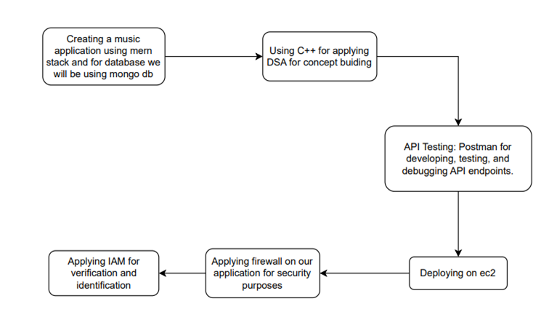

Slide 12


‣ Strengths
‣ Our competitive advantage lies in the integration of Data Structures and Algorithms (DSA) to enhance music management functionality, providing efficient search, sorting, and playlist management capabilities that outperform standard music players in terms of speed and user experience.
‣ Our core music management functionalities, such as quick search and efficient playlist organization, are expected to perform well due to the use of optimized algorithms
‣ Additionally, features promoting new artists can attract a dedicated user base interested in discovering fresh music.
‣ Weaknesses:
‣ Initially, features related to artist promotion may underperform if not marketed effectively to both users and artists. The music discovery algorithm might also need continuous refinement to effectively highlight emerging artists without overwhelming users
‣ Opportunities:
‣ We can leverage machine learning to enhance the music recommendation engine, which could suggest songs based on user behavior and preferences.
‣ Integrating cloud storage could also allow users to access their music libraries from multiple devices
with their social media and smart devices, which could pose a challenge if we do not adapt to these trends.

Slide 13
Implementation
Data Structure :
Created functions like :
Add Song
Delete Song
Search
Display the songs
Recently played songs

Slide 14
Front End
Technologies Used:
HTML: Structure for web pages (Home, Login, Signup, User).
CSS: Styling to enhance visual appeal (custom styles in style.css).
Bootstrap: Responsive design with pre-built components for layout.
Font Awesome: Icons for social media links.
2. Key Features Implemented:
Navigation Bar:
Dynamic links for easy navigation (Home, Login, Sign Up).
Search functionality integrated within the navbar.
Home Page:
Welcoming message and key features highlighted using headings and lists.
Responsive layout with Bootstrap’s grid system for proper alignment.
Login & Signup Forms:
Form validation with required fields (username, password, email).
User-friendly design with clear labels and button styles.
Action buttons styled for a consistent look.
User Page:
Music player controls designed for user interaction (play, pause, skip).
Sidebar integration for navigation (future features can be added).
3. Design Considerations:
Responsive Design: Ensured compatibility across devices using Bootstrap classes.
Color Scheme: Warm color palette for a friendly user experience.
User Experience: Clear navigation, intuitive forms, and visual feedback on button interactions

Slide 15
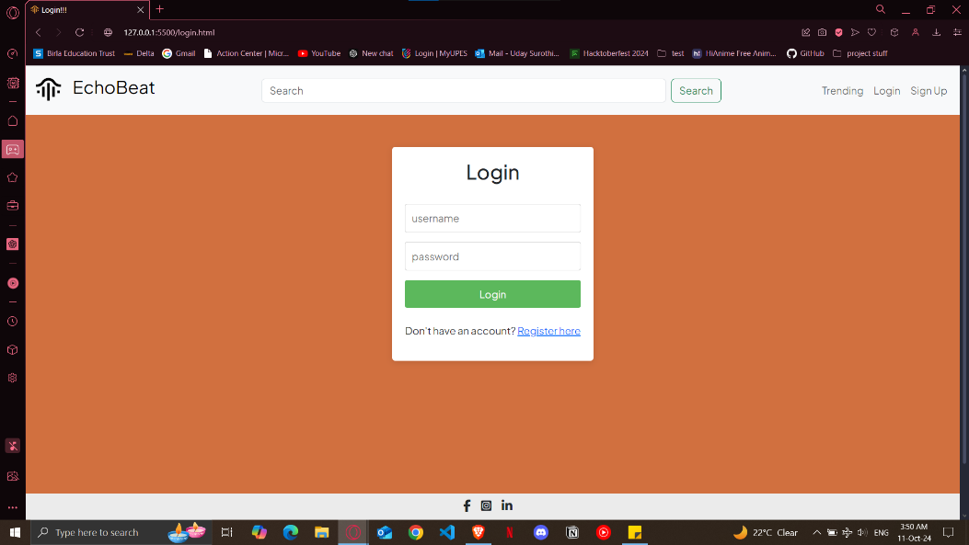
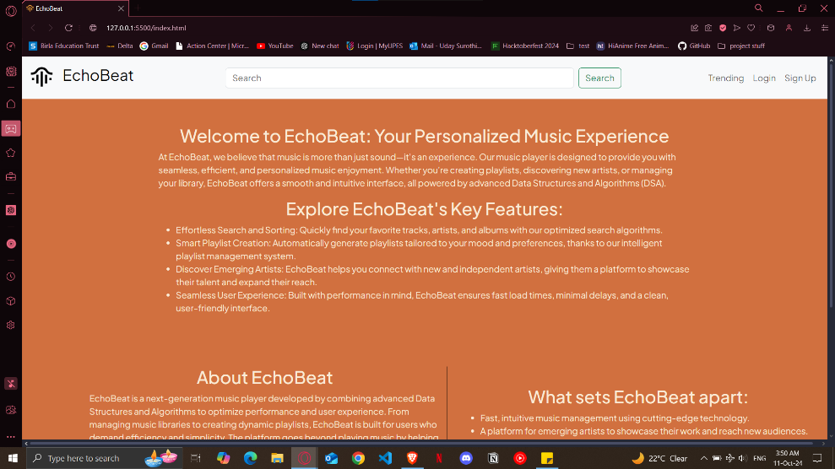
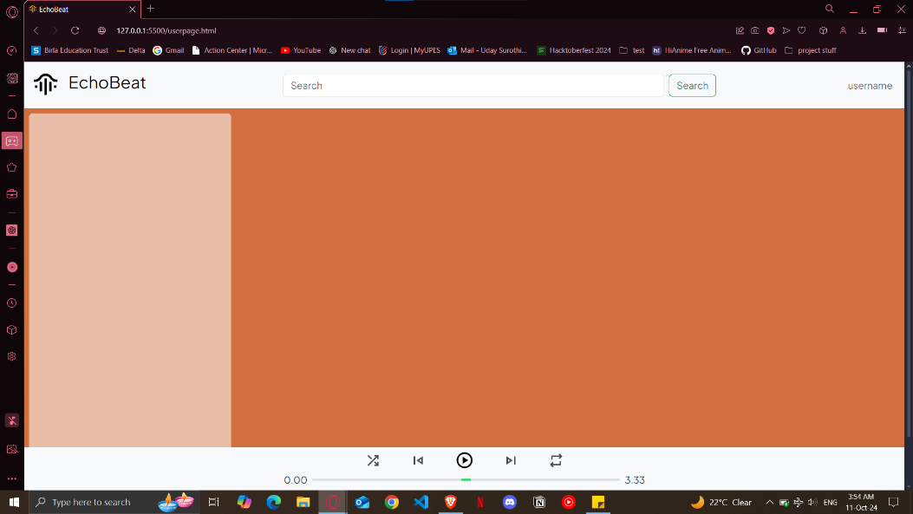
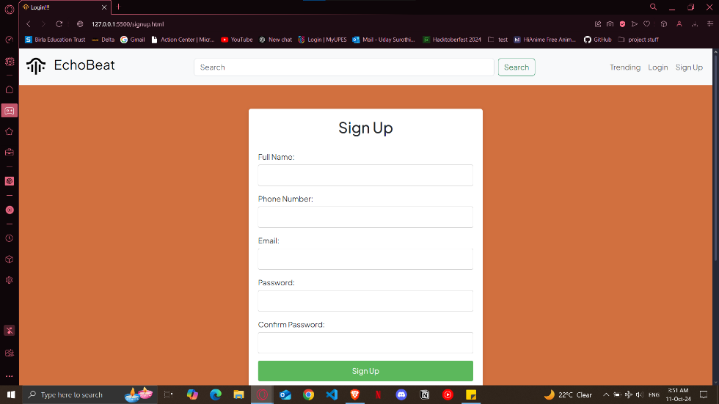
Front End
Home
Login
Signup
User page

Slide 16
Back End
Technologies Used:
Node.js & JavaScript: Developed the core logic and APIs for seamless interaction between the client and server.
MongoDB: Implemented efficient data storage and retrieval mechanisms for user data, playlists, and song metadata, ensuring scalability and performance.
Tokenization and Encryption: Incorporated secure tokenization for user authentication and sensitive data handling, along with encryption protocols to protect user information and maintain privacy.
Key Features:
User Management: Secure registration, login, and profile management.
Playlist Creation: Dynamic playlist functionality with user-specific data storage.
Song Metadata Handling: Efficient retrieval and management of song details to enhance user experience.

Slide 17
‣ Threats
Changes in digital content licensing laws and regulations around music streaming could impact our ability to legally provide certain features.
‣ Additionally, evolving data privacy laws may require us to update how we handle user data. Users also increasingly expect seamless integration with their social media and smart devices, which could pose a challenge if we do not adapt to these trends.

Slide 18
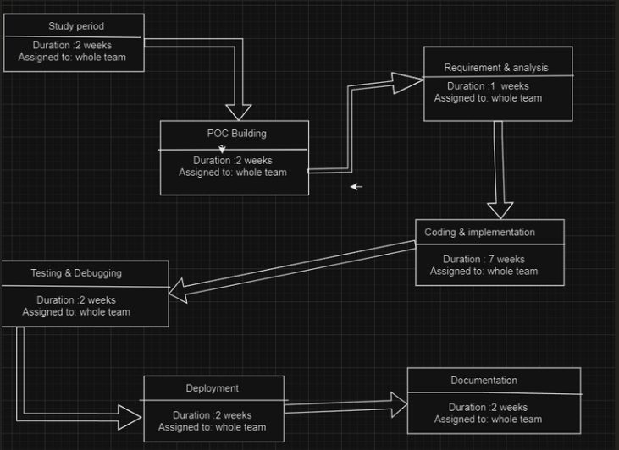

Fig.6 Program Evaluation Review Technique Chart

Slide 19
References
1 Aljunid, M. F., & Dh, M. (2020). An efficient deep learning approach for collaborative filtering recommender system. Procedia Computer Science, 171, 829–836. https://doi.org/10.1016/j.procs.2020.04.090
2 Aaron, V. D. O., Dieleman, S., & Schrauwen, B. (2013). Deep content-based music recommendation. https://proceedings.neurips.cc/paper/2013/hash/b3ba8f1bee1238a2f37603d90b58898d-Abstract.html
3 Sánchez-Moreno, D., González, A. B. G., Vicente, M. D. M., Batista, V. F. L., & García, M. N. M. (2016). A collaborative filtering method for music recommendation using playing coefficients for artists and users. Expert Systems With Applications, 66, 234–244. https://doi.org/10.1016/j.eswa.2016.09.019
4 Liao, C., & Lee, S. (2016). A clustering based approach to improving the efficiency of collaborative filtering recommendation. Electronic Commerce Research and Applications, 18, 1–9. https://doi.org/10.1016/j.elerap.2016.05.001

Slide 20
References
5 Automatic playlist generation using Convolutional Neural Networks and Recurrent Neural Networks. (2019, September 1). IEEE Conference Publication | IEEE Xplore. https://ieeexplore.ieee.org/abstract/document/8903002?casa_token=57Ip3JWapxAAAAAA:OVtxa1fiUdIOsQx_t7gXHYa_x1sbWEL5fDTlwBrFRgPVR678YHTySbpCH5Gxhlgdmz0n8A_24etuVbs
6 Music recommendation system using human activity recognition from accelerometer data. (2019b, August 1). IEEE Journals & Magazine | IEEE Xplore. https://ieeexplore.ieee.org/document/8743473
7 Park, S., Laplante, A., Lee, J. H., & Kaneshiro, B. (2019). Tunes Together: Perception and experience of collaborative playlists. https://www.semanticscholar.org/paper/Tunes-Together%3A-Perception-and-Experience-of-Park-Laplante/9761c7ce3db2ef0c421c37eec916c7c9904b5917
8 Semantic Scholar topic. (n.d.). https://topics-beta.apps.semanticscholar.org/topic/4577034884?corpusId=195720338

Slide 21


